Slide 1

More Binary and Floating Points
Computer Organization

Slide 2


1. Intro
Lesson 1 Review
Binary Addition
Binary Subtraction
Practice
Fixed Point Binary Fractions
Practice
Floating Point Binary Fractions
Practice

Slide 3
Base 10

Slide 4
Base 10 (decimal)
0 1 2 3 4 5 6 7 8 9
digits
431

Slide 5
Base 10 (decimal)
10000 | 1000 | 100 | 10 | 1
 |  | 4 | 3 | 1
(4 * 100) + (3 * 10) + (1 * 1) = 431

Slide 6
Convert Base 10 to Base 2
10000 | 1000 | 100 | 10 | 1
 |  | 2 | 3 | 1
128 | 64 | 32 | 16 | 8 | 4 | 2 | 1
1 | 1 | 1 | 0 | 0 | 1 | 1 | 1

Slide 7
Base 2

Slide 8
Base 2 (binary)
0 1
binary digits (bits)
00100101

Slide 9
Base 2 (binary)
128 | 64 | 32 | 16 | 8 | 4 | 2 | 1
0 | 0 | 1 | 0 | 0 | 1 | 0 | 1
(1 * 32) + (1 * 4) + (1 * 1) = 37

Slide 10
Character Representation

Slide 11
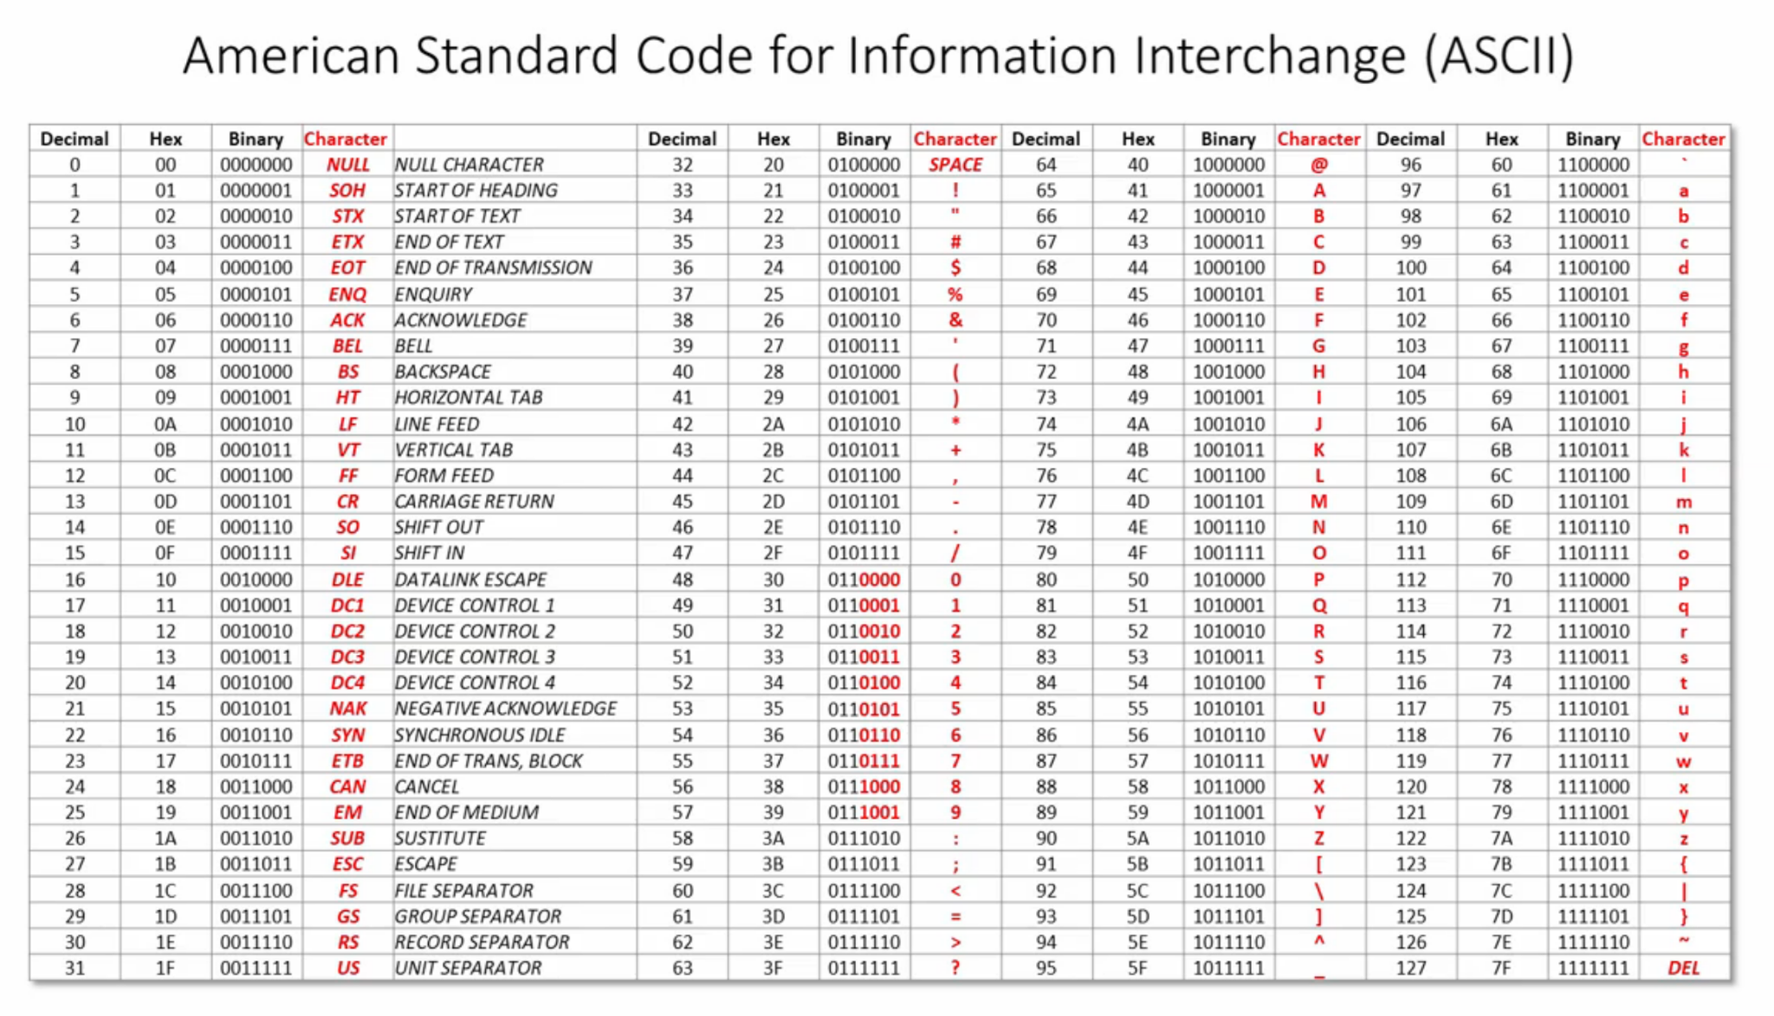
Notes:
ASCII abbreviated from American Standard Code for Information Interchange, is a character encoding standard for electronic communication. ASCII codes represent text in computers, telecommunications equipment, and other devices. Most modern character-encoding schemes are based on ASCII, although they support many additional characters.
The Internet Assigned Numbers Authority (IANA) prefers the name US-ASCII for this character encoding.
Different bit patterns are used for each different character that needs to be represented.
Because of this difference between the integer representation for a character, and the character representation for a character, we constantly need to convert from one to the other.
The computer does arithmetic operations on two's complement integers (and often operations on unsigned integers). The computer has the ability to read in or print out a single character representation at a time. So, any time we want to do I/O, we're working with one character at a time, and the ASCII representation of the character. Yet, lots of the time, the data represents numbers (just consider integers, for now).
8-bits increased the number of characters range.
Early on most computer manufacturers where creating their own set of characters. Microsoft and IBM each made dozens. Know as codepages.
It became platform dependent
WWW increased this problem
When data moved from one place to another possibly different system or storage devices. Data was not well represented.
Then, it came Unicode
The idea was to create a single character set in which every single platform has a unique character.

Slide 12

Notes:
Unicode is an information technology standard for the consistent encoding, representation, and handling of text expressed in most of the world's writing systems. The standard, which is maintained by the Unicode Consortium, defines 143,859 characters covering 154 modern and historic scripts, as well as symbols, emoji, and non-visual control and formatting codes. Unicode 14.0 is now in beta with 144,697 characters, including 5 new scripts, and 37 new emoji characters.

Slide 13
Character Representation - Summary
ASCII is a 7 bit encoding system for a limited number of characters
Extended ASCII resulted in lots of incompatible code pages
Unicode allows every character in every written language to be encoded
Unicode is backwards compatible with ASCII
Unicode is space efficient
Unicode Transformation Format (UTF-8) uses 1, 2, 3 or 4 bytes
Unicode is universally supported

Slide 14
Two’s Complement - Summary
Computers use two’s complement to represent negative numbers in binary
Half of the available combinations of bits are used to represent negative numbers

Slide 15
Binary Addition

Slide 16
Adding a bit
1
1
10
1
1
1
11
0 + 0 = 0
0 + 1 = 1
1 + 0 = 1
1 + 1 = 0 with 1 carry
1 + 1 + 1 = 1 with 1 carry
1
1

Slide 17
4 bits addition
8 | 4 | 2 | 1
1 1
1011
0011
11
3
1110
14

Slide 18
4 bits addition - overflow
8 | 4 | 2 | 1
1
1001
1000
9
8
x
0001
17

Slide 19
8 bits addition
128 | 64 | 32 | 16 | 8 | 4 | 2 | 1
1
1
0111 0000
0010 1010
112
42
1001 1010
154

Slide 20
8 bits addition - overflow
128 | 64 | 32 | 16 | 8 | 4 | 2 | 1
1 1 1 1 1 1 1
1011 0110
0111 1010
182
122
x
0011 0000
304

Slide 21
Binary Subtraction

Slide 22
Subtracting a bit
1 0
1
0 1
0 - 0 = 0
0 - 1 = 1 with 1 borrow
1 - 0 = 1
1 - 1 = 0
0 2
x
Notes:
4
7
0 - (-1) = 1
0101 => 5
0010 => 2
0011
00
11
01

Slide 23
4 bits subtraction
8 | 4 | 2 | 1
1011
- 0011
11
- 3
1000
8

Slide 24
8 bits subtraction
128 | 64 | 32 | 16 | 8 | 4 | 2 | 1
0 1 1 2
0111 0000
- 0010 1010
112
- 42
0100 0110
70

Slide 25
Practice

Slide 26
Adding binary values
1011
0110
----------
1100 1010
0011 1111
-----------------
1110
0111
----------
0100 0000 - 0011 1100
-----------------

Slide 27
Fixed Point Binary Fractions

Slide 28
8 bits with 3 bits precision
16 | 8 | 4 | 2 | 1 | 1/2 | 1/4 | 1/8
0 | 1 | 1 | 0 | 1 | 1 | 0 | 0
binary point
8 + 4 + 1 + ½ = 13 ½

Slide 29
8 bits with 3 bits precision
16 | 8 | 4 | 2 | 1 | .5 | .25 | .125
1 | 0 | 1 | 1 | 0 | 0 | 1 | 1
binary point
16 + 4 + 2 + .25 + .125 = 22.375

Slide 30
12 bits with 4 bits precision
128 | 64 | 32 | 16 | 8 | 4 | 2 | 1 | .5 | .25 | .125 | .0625
1 | 0 | 1 | 1 | 0 | 1 | 0 | 0 | 1 | 0 | 0 | 1
binary point
32 | 16 | 8 | 4 | 2 | 1 | .5 | .25 | .125 | .0625 | .03125 | .015625
1 | 0 | 1 | 1 | 0 | 1 | 1 | 1 | 1 | 0 | 1 | 1
128 + 32 + 16 + 4 + .5 +.0625 = 180.5625
Notes:
No possible to represent this value using this Fixed Binary Fractions scheme
180.8010 ?.796875
(1 * .5) + (1 *.25) + (1 * .125) = .8750
(1 * .5) + (1 *.25) + (1 * .0625) = ..8125
(1 * .5) + (1 *.25) = .7500
0-255

Slide 31
Two’s complement 12 bits with 4 bits precision
-128 | 64 | 32 | 16 | 8 | 4 | 2 | 1 | .5 | .25 | .125 | .0625
1 | 0 | 0 | 1 | 1 | 0 | 1 | 1 | 0 | 1 | 1 | 0
binary point
-128 + 16 + 8 + 2 + 1 + .25 +.125 = -100.375

Slide 32
Practice

Slide 33
Each binary number is stored using Two’s complement 12 bits with 4 bits precision. Convert to decimal
101001011000
010111011100
001001010110

Slide 34
Using two’s complement, convert into fixed point binary. Result should be in 12 bits with 4 bits after the binary point
13.5
-86.75
-1.5

Slide 35
Summary
Fixed point binary is used in Digital Signal Processing
Simpler and therefore cheaper processor hardware
Greatly simplified arithmetic means much faster processing
Trade off between range and precision
Some numbers can never be represented accurately
Used in real time application when performance is more important than accuracy

Slide 36
Floating Point Binary Fractions
Notes:
Most modern computer use floating point to represent real numbers.
Why? Because floating point binary makes particular efficient use of the computer hardware.
Representing extremely large, small or values that require high degree of precision

Slide 37
Expressing values using
Scientific Notation
300 = 3 × 10²
0.2 = 2 × 10⁻¹
987 = 9.87 × 10²
Notes:
Scientific notation is a way of expressing numbers that are too large or too small (usually would result in a long string of digits) to be conveniently written in decimal form. It may be referred to as scientific form or standard index form, or standard form in the UK. This base ten notation is commonly used by scientists, mathematicians, and engineers, in part because it can simplify certain arithmetic operations. On scientific calculators it is usually known as "SCI" display mode.
In scientific notation, nonzero numbers are written in the form
m × 10^{n}

Slide 38
Standard Scientific Notation using positive exponent
mantissa
exponent
2.99 × 10⁸
m × 10^{n}
299000000.
Notes:
Speed of light in a vacuum measured in meter per second
299 million meters per second
The more digits in the mantissa we can express values with greater precision
The number of digits written in the mantissa govern the precision
The number of digits written in the exponent govern the range

Slide 39
Standard Scientific Notation using negative exponent
mantissa
exponent
1.60 × 10⁻¹⁹
0.000000000000000000160
Notes:
Charge on a electron
This is a very small fraction

Slide 40
Floating point inside the computer
mantissa
exponent
 |  |  |  |  |  |  |  |  |  | -32 | 16 | 8 | 4 | 2 | 1
0 | 1 | 1 | 0 | 1 | 0 | 0 | 0 | 0 | 0 | 0 | 0 | 0 | 0 | 1 | 1
imaginary point
sign bit
sign bit
0 | 1 | 1 | 0 | 1 | 0 | 0 | 0 | 0 | 0
x 2³
4 | 2 | 1 | .5
1 | 1 | 0 | 1
4 + 2 + .5 = 6.5
Notes:
16 bits register
10 bits dedicate to the mantissa
6 bits dedicated to the exponent
Two’s complement used in both
IEEE standard

Slide 41
Floating point inside the computer
mantissa
exponent
0 | 1 | 0 | 1 | 0 | 1 | 0 | 0 | 0 | 0 | 0 | 0 | 0 | 0 | 1 | 0
imaginary point
sign bit
sign bit
0 | 1 | 0 | 1 | 0 | 1 | 0 | 0 | 0 | 0
x 2²
2 | 1 | .5 | .25 | .125
1 | 0 | 1 | 0 | 1
2 + .5 + .125 = 2.625
Notes:
16 bits register
10 bits dedicate to the mantissa
6 bits dedicated to the exponent
Two’s complement used in both
IEEE standard

Slide 42
Floating point inside the computer
mantissa
exponent
 |  |  |  |  |  |  |  |  |  | -32 | 16 | 8 | 4 | 2 | 1
0 | 1 | 0 | 0 | 0 | 0 | 0 | 0 | 0 | 0 | 1 | 1 | 1 | 1 | 1 | 0
imaginary point
sign bit
sign bit
0 | 1 | 0 | 0 | 0 | 0 | 0 | 0 | 0 | 0
x 2⁻²
1 | .5 | .25 | .125
0 | 0 | 0 | 1
= .125
Notes:
16 bits register
10 bits dedicate to the mantissa
6 bits dedicated to the exponent
Two’s complement used in both
IEEE standard

Slide 43
Practice

Slide 44
Convert floating point binary to decimal. Assume 10 bits mantissa and 6 bits exponent, both two’s complement
0110110100000010
0101100000111111

Slide 45
2. End
Collaborate on Slack
Binary and Floating Points operations
Complete practice problems
Download Logisim-evolution
Test that you are able to run on your computer.

